Slide 1
Converting Measurements

Slide 2
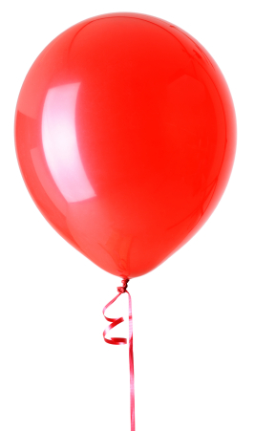
What unit would you use to measure these?

Slide 3
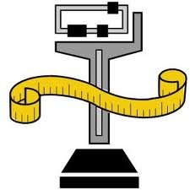
Length
Kilometre | Metre | Centimetre | Millimetre
1 000 m | 1 | 1/100m | 1/1000m

Slide 4
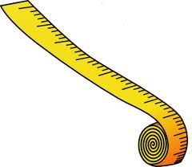
Length
The SI unit is metre
A kilometre is 1000m – so it is larger than a metre, if we have to convert from metre to kilometre we will multiply
For example 1km = 1000m
So 2km = 2x1000= 2000m
And 3.5 km = 3.5x1000 = 3 500m

Slide 5
Centimetre
A centimetre is one hundredth of a metre, it is smaller.
So 1 metre = 100cm (1/100)
For example: 2 m = 2 x 100 = 200cm
4.5 m = 4.5x100 = 450m
70cm = 1/ 100 x 70 = 0.7 m
120 cm = 1/100 x 120 = 1.2m

Slide 6
Millimetre
A millimetre is one thousandth of a metre (1/1000)
So there are 1000 mm in a metre
There are 10 mm in a 1cm
In 4 metres = 4 x 1000 = 4000m
In 2 cm = 2 x 10 = 20mm

Slide 7
Question
How many mm are there in 2km?
1 m = 1000 mm
1km = 1000m
So 1km = 1000m x 1000mm
= 1 000 000 mm
So 2 km = 2 x 1 000 000mm
= 2 000 000 mm

Slide 8
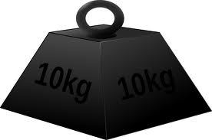
Mass
Tonne | Kilogram | Gram | Milligram
1 000 kg | 1 | 1/1000 kg | 1/ 1 000 000

Slide 9
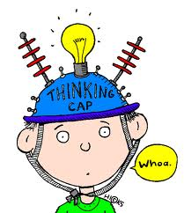
Questions
How many g are there is 4 kg?
1 kg = 1000g
So 4 kg = 4 x 1000g = 4000g
How many mg in 4 kg?
There are 1 000 000 mg in 1 kg
So 4 kg = 4 x 1 000 000
= 4 000 000

Slide 10
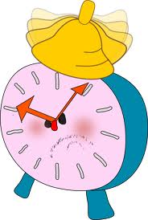
Time
How many minutes are there in an hour?
How many seconds are there in an hour?
How many seconds are there in a day?

Slide 11
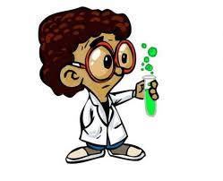
Errors
Errors from scientific measurements may be due to:
the equipment,
the experimenter
the environment

Slide 12
Errors due to the Equipment
This may be caused by inaccurate calibration of the equipment

Slide 13
Errors due to the Experimenter
This usually manifests itself in poor experimental skills in reading measuring devices and may appear as parallax errors

Slide 14
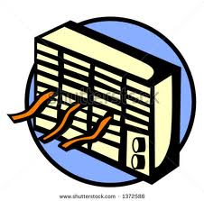
Errors due to the environment
The conditions in which an experiment is conducted may adversely affect the quantity of measurements
For example measuring temperature (how hot) of a substance in an air conditioned room

