Slide 1
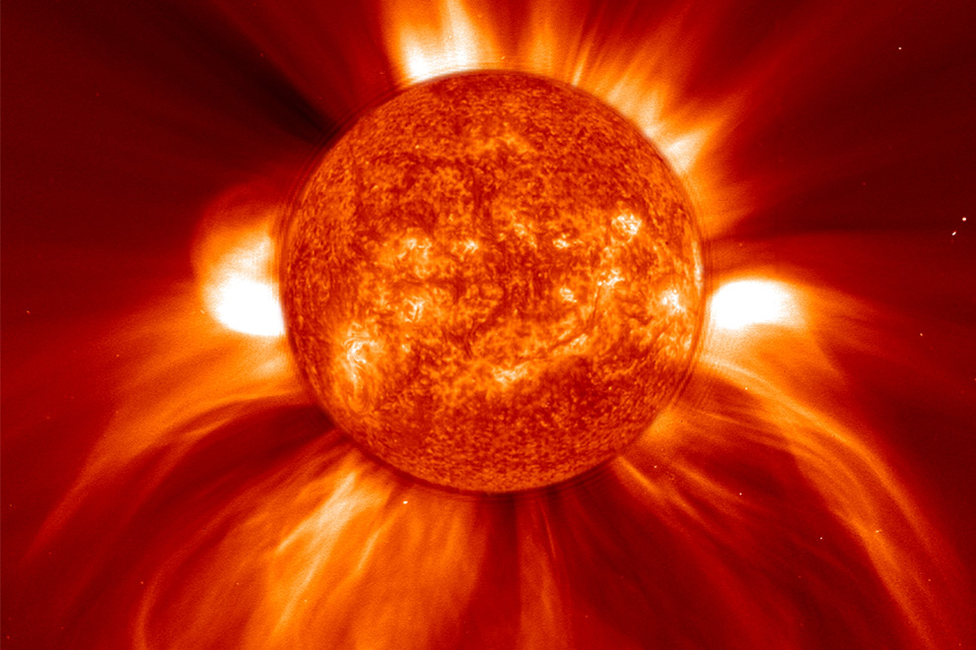
Fusion in the Sun

Slide 2
What do we know about the Sun?
It is a star
It produces light and heat on Earth
Plants need it for photosynthesis
The Sun fuels our food chains
It is the main source of energy on Earth

Slide 3
Some more facts about the Sun
The Sun is one of more than 200 billion stars in the galaxy known as the Milky Way
It is a medium sized star of about 4.6 billion years old
It is 300 000 times heavier than Earth
It has a large mass which causes it to exert a large gravitational force on all the objects around it
The Sun’s gravity keeps the planets in orbit

Slide 4
Did you know?
The next star nearest to the Earth is called Proxima Centuari.
It is about 4.3 light years away
One light year is the distance light travels in one year
It takes 8 minutes for the light from the Sun to reach the Earth

Slide 5
How does the Sun Produce Energy?

Slide 6
Fusion
The sun is made up mainly of Hydrogen and Helium
In the Sun a nuclear reaction occurs – this means the nucleus of the atoms react
The Hydrogen in the Sun undergoes nuclear fusion which produces Helium and gives out vast amounts of energy

Slide 7
Nuclear Fusion
In nuclear fusion two lighter Hydrogen nuclei (singular nucleus) are fused together to form a larger Helium nucleus (two protons ), releasing energy in the process
The energy produced is given off in the form of light and heat
The core or the centre of the Su has a very high temperature (14 million ºC)
This is where nuclear fusion of hydrogen takes place

Slide 8
Recap Questions
What is fusion?
What two atoms are fused in the Sun?
What do these atoms form after they have fused?
What is released when the atoms fuse?
Where in the Sun does nuclear fusion occur?

