Slide 1
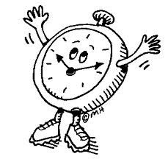
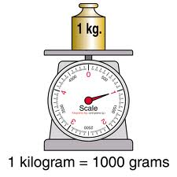
Measurement
Physical quantities

Slide 2
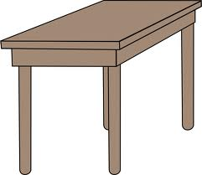
Activity
Use your hand span to measure the length of your desk
What result did you get?
Do you think there is a need for standardized measurement?

Slide 3
Lets Travel Back In Time

Slide 4
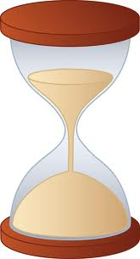
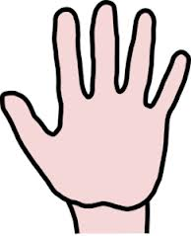
Units of Measurements Used Long Ago In Different Parts of the World
Hourglass
Balance
Elbow
Hand

Slide 5
Physical Quantity
A physical quantity is a quantity which can be measured.
Examples of physical quantities are:
Length – the distance between two points
Mass – the amount of matter in an object
Volume – the amount of space taken up by an object
Time – a measurement period
Temperature – how hot or cold a substance is

Slide 6
SI units
SI stands for Systeme International d’ Unites (in French)
A standardized unit is needed as measurement is a global phenomena and is needed throughout the world

Slide 7
Common Physical Quantity & Units
Physical quantity | Physical Quantity Symbol | SI unit | Symbol for unit
Length | L | Metre | m
Mass | M | Kilogram | kg
Time | t | Second | s
Temperature |  | Kelvin | K
Electric Current | I | Ampere | A

Slide 8
Common SI prefixes
Prefix | Symbol | Standard Form | Meaning
Mega | M | 1x10⁶ | One million (1 000 000)
Kilo | k | 1x10³ | One thousand (1000)
Centi | c | 1x10⁻² | One hundredth (1/100)
Milli | m | 1x10⁻³ | One thousandth (1/1 000)
Micro | ^{µ} | 1x10⁻⁶ | One millionth (1/1 000 000)
Pico | p | 1x10⁻¹² | One million millionth (1/ 1 000 000 000 000)

Slide 9
Examples
One millimeter is equal to one thousandth of a metre (1mm = 1/1000)
One centimetre (cm) is equal to one hundreth of a metre (1cm= 1/100m)
One kilometre (km) is equal to one thousand metres (1km = 1000m)

Slide 10
Length
Length is the distance between two points
It’s SI unit is the metre (m)
Short distances are measured in centimetres (cm) and millimetres (mm)
Very short distances are measured in micrometres, for example the size of bacterium
Very large distances are measured in kilometres (km)

Slide 11
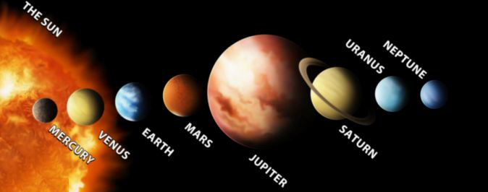
Did You Know
Very large distances for example, the distances between the planets are measured in astronomical units (AU)
One astronomical unit represents a distance of 150 million kilometres.

Slide 12
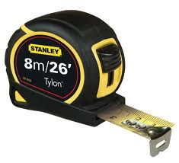
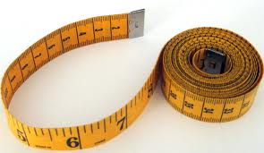
Instruments used for measuring length
Metre rule
Measuring tape

Slide 13
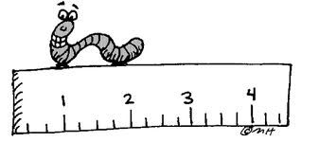
Activity
What instrument and unit would you use to measure:
The length of your desk?
The width of your text book?
The perimetre of your classroom?

Slide 14
Errors in measuring length – Parallax error
Parallax error is an error in a measurement due to the eye not being in the correct position when taking a reading
Zero error – when the measurement is taken at any point besides zero

Slide 15
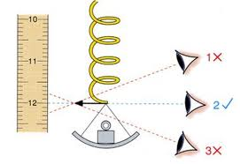
Parallax errors

Slide 16
Reducing Parallax Errors
Placing the eye vertically above the marking on the scale to be read
Placing the metre rule on the edge beside the object to be measured so that the scale is touching it
Using a thin ruler so that the scale is touching the object to be measured.

Slide 17
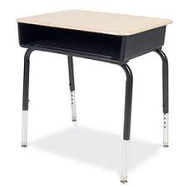
Measuring the length of your desk
Following the precautions to avoid measurement errors, measure the length of your desk

Slide 18
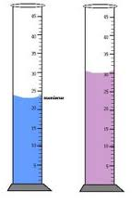
Volume
Volume is a measure of the space occupied by a substance
The SI unit for volume is the cubic metre (m3)
Other common units include mm3, cm3, millilitre (ml) and centilitre (l)

Slide 19
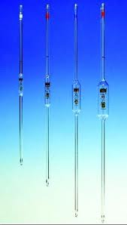
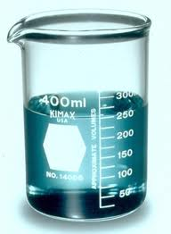
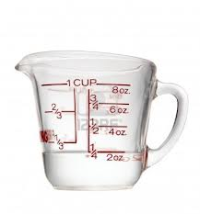
Instruments used for measuring volume

Slide 20
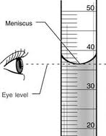
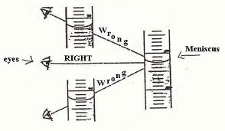
Errors in Measuring volume
Meniscus readings – readings should be taken at the bottom of the meniscus
Readings should also be taken at eye level to avoid parallax errors

Slide 21
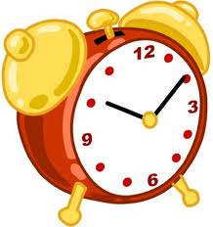
Time
Time is a measurement period
The SI unit is the second (s)
Other units for time include: minutes (min), hours (h), days, months, years, decades and centuries.

Slide 22
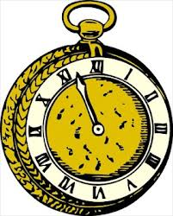
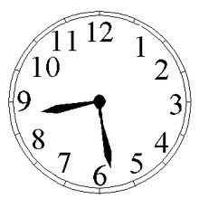
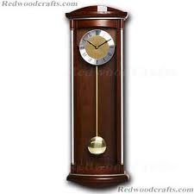
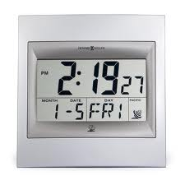
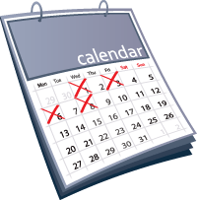
Instruments used to measure time

Slide 23
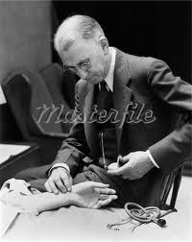
Activity
Using the stop clocks provided, work in pairs to time your friends pulse for 30 seconds
Record your answer in beats per minute

Slide 24
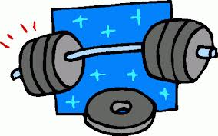
Mass
The mass of an object is the measure of the amount of matter in it
Remember matter is anything which occupies space.
The SI unit for mass is the kilogram (kg)
Large masses are measured in tonnes
(1tonne = 1000kg)
Small masses are measured in grams (g), milligrams (mg) and micrograms

Slide 25
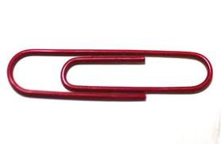
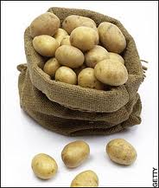
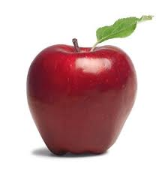
What unit would you use to measure these:

Slide 26
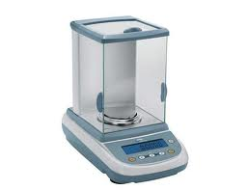
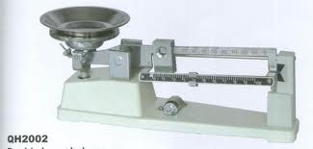
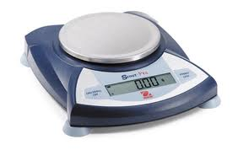
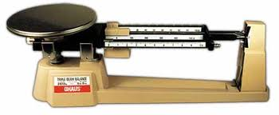
Instruments used for measuring mass

Slide 27
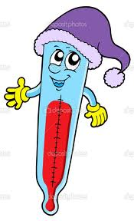
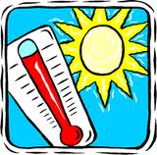
Temperature
The temperature of a substance tells use how hot or cold a substance is
The SI unit for temperature is the Kelvin and the unit is also called the Kelvin
We, however measure according to the Celsius scale and the unit is called degrees Celsius

Slide 28
Converting Kelvin to Celsius
Temperature in Kelvin=Temperature in C +273
For example 27 C = 27 + 273
= 300K

Slide 29
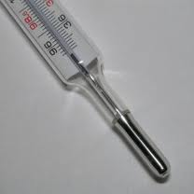
Instruments for measuring temperature

