Slide 1
Planets of the Solar System
Characteristics/Composition /Position

Slide 2
Planets of the Solar System
Planets
Terrestrial
Mercury
Venus
Gas Giants
Jupiter
Earth
Saturn
Uranus
Neptune
Mars

Slide 3
The Solar System Song

Slide 4
Terrestrial Planets
These planets are solid and rocky
There are four terrestrial planets Mercury, Venus, Earth and Mars

Slide 5
Mercury Characteristics
Nearest planet to the Sun
Smallest planet
No moons
88 Earth days for one revolution around the Sun (88days = 1year on Mercury)
It spins slowly 59 Earth days for 1 rotation on its axis

Slide 6
Mercury
Iron core / rocky crust
Weak gravity – no atmosphere
High temperature in the day
Low temperature at night
Many craters due to no atmosphere

Slide 7
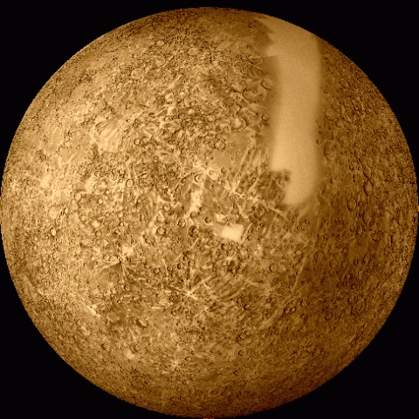
Planet Mercury

Slide 8
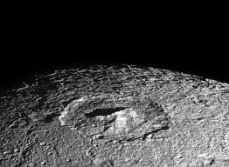
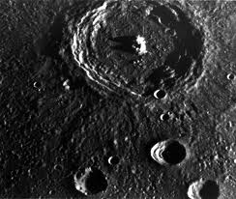
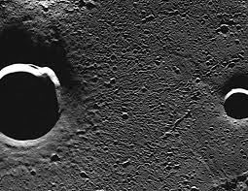
Mercury Craters

Slide 9
Mercury Core

Slide 10
Did you know???
Mercury is the planet which most looks like our Moon – it is full of craters
All gases except traces of vaporized Sodium have been boiled off by the Sun

Slide 11
Venus
Second Planet from the Sun
Almost the size of Earth
Internal structure similar to Earth
Very hot – average temperature 464ºC (Earth is 15ºC)
Thick and Acidic Atmosphere (carbon dioxide & sulphuric acid)
No moon
Spins the opposite direction to Earth

Slide 12
Planet Venus

Slide 14
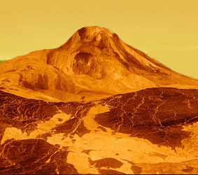
Venus’s Surface

Slide 15
Did You Know?
You would not be able to see stars from Venus because the atmosphere of thick poisonous gas clouds block out the Sun and stars
The sky looks red and it is impossible to see the surface of Venus from Earth
Venus has rainfall of acid
All space probes that landed on Venus only kept working for 1 hour

Slide 16
Earth
Third planet from the Sun
Rocky surface
Atmosphere present – rich in oxygen and nitrogen little carbon dioxide
Takes 365 ¼ days for one revolution around the Sun
Takes 24hours to rotate on its axis
Only known planet to have water and support life
Has one moon – called “The Moon”

Slide 17
Earth

Slide 18
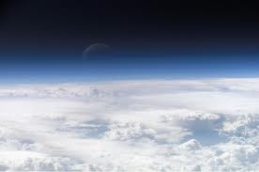
Earth’s Atmosphere

Slide 19
Mars
Known as the red planet – due to iron (III) oxide (rust compound) on its surface
4th planet from the Sun, last inner planet
Small iron core, rocky crust
Atmosphere – carbon dioxide, no oxygen
Polar icecaps
Two small moons

Slide 20
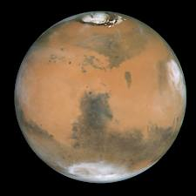
The Red Planet

Slide 21
Mars’ Moons

Slide 22
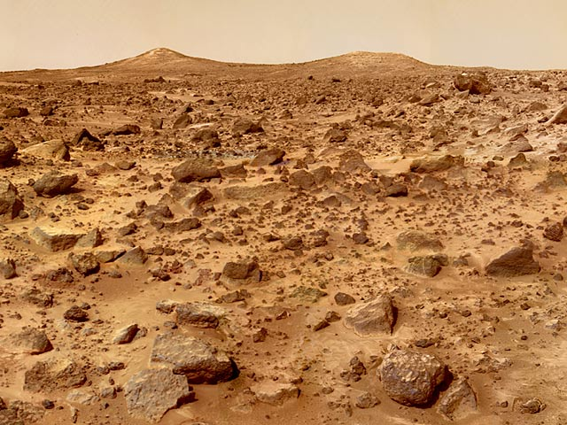
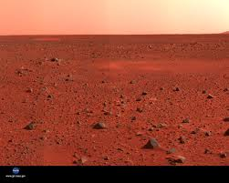
Mars’ Surface

Slide 23
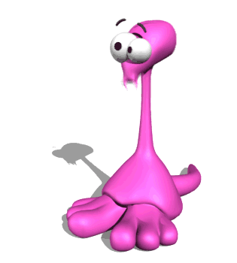
Did You Know?
The rocks on Mars contain a lot of iron dust which adds to its color
This dust has been oxidized by the carbon dioxide gas in the atmosphere
This chemical reaction has turned Mars dusty

Slide 24
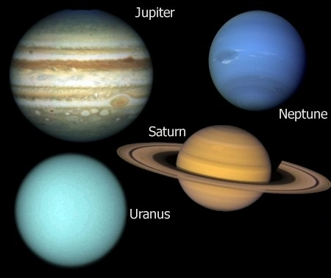
Outer planets – “Gas Giants”
Jupiter, Saturn, Neptune, Uranus

Slide 25
Outer Planets
The outer planets are also known as the Gas Giants, this is because they are huge and composed of gases!
The outer planets are the largest in the solar system

Slide 26
Jupiter
5th planet from the sun
Largest and heaviest in the solar system
Atmosphere made of hydrogen with some helium
Spins very fast – so there are violent storms
Home to the Great Red Spot – a storm larger than Earth
Has 63 moons

Slide 27
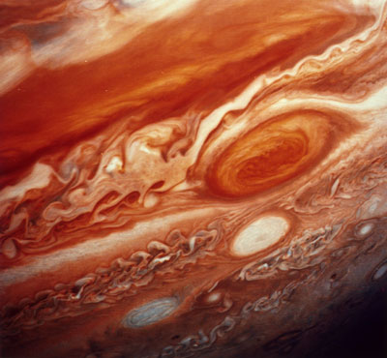
Jupiter
The Great Red Spot (below )

Slide 28
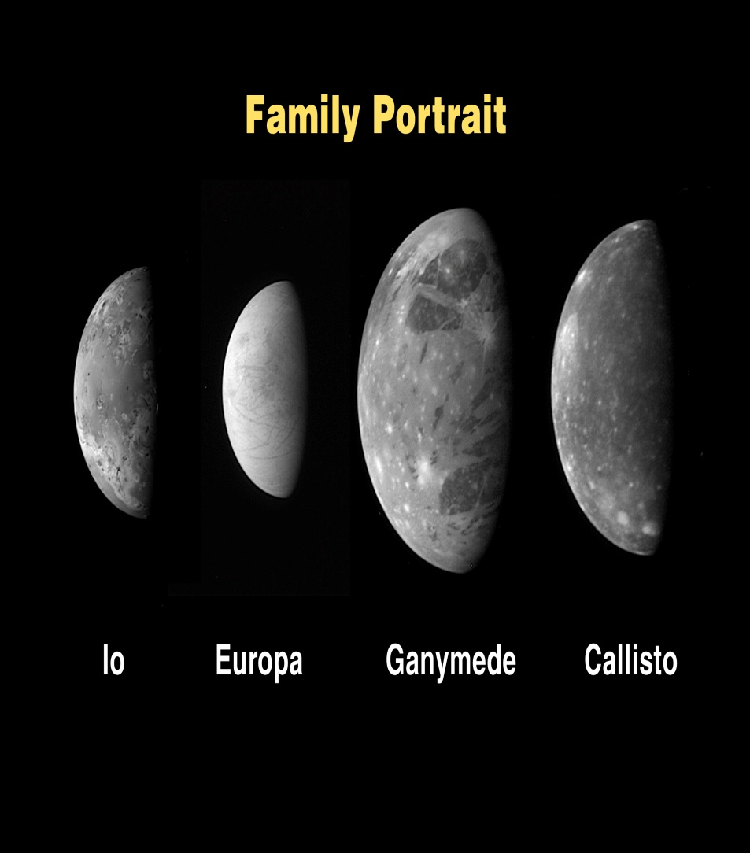
Jupiter’s Moons

Slide 29
Saturn
6th planet from the Sun
2nd largest in the solar system
Rocky core surrounded by metallic hydrogen
Atmosphere – hydrogen and helicum
Rings composed of ice and space debris
Has about 33 moons. Titan is the largest and is the size of a small planet

Slide 30
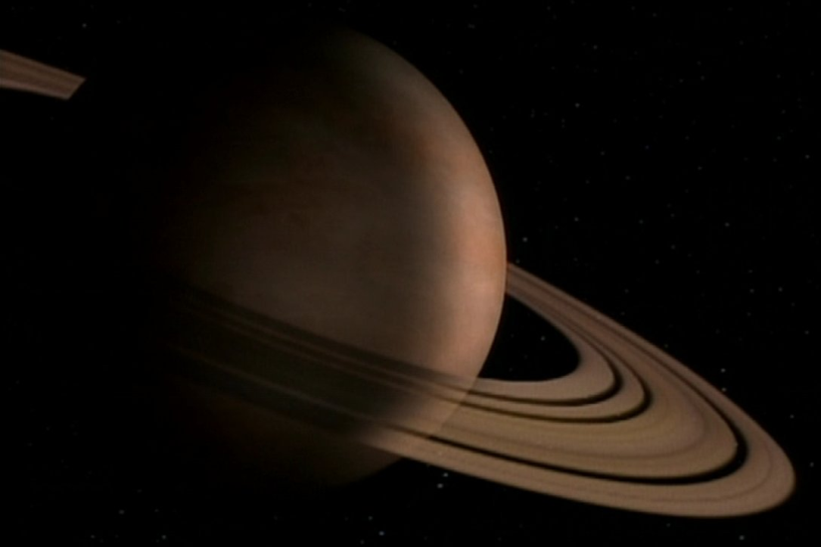
Saturn

Slide 31
Saturn’s Moons

Slide 32
Uranus
7th planet from the Sun
3rd largest and 4th heaviest
It takes 84 Earth years for one revolution around the Sun
It is extremely cold
Atmosphere – hydrogen with small amount of methane
Methane gives Uranus a cyan (blue-green) color
It is tilted at an angle of 98º

Slide 33
Uranus

Slide 34
Uranus Tilt

Slide 35
Uranus Moons

Slide 36
Neptune
8th planet from the sun
Atmosphere – mainly hydrogen, some helium and a little methane
These gases gives it a bluish green color
Neptune is extremely cold
Revolution: 165 earth years
Stormiest weather in the solar system – winds 2 000km/h. Hurricanes on Earth 300km/h
13 moons – Triton (largest)

Slide 37
Neptune

Slide 40
Pluto
Pluto is no longer a planet
It is considered a “dwarf planet”
A dwarf planet is one which cannot clear objects out of its path
Pluto is also much smaller than the other planets.

Slide 41
Dwarf Planet – Pluto

