Slide 1
Smoking Kills
Chapter 26

Slide 2
Video

Slide 3
What are cigarettes made of?
Cigarettes are made of dried tobacco leaves
When a cigarette is burnt chemical changes take place
The tobacco smoke produced contains more than 4,000 chemicals, many of which are harmful to the human body.

Slide 4
What cigarettes are really made of ……

Slide 5
What does tobacco smoke contain?
Nicotine (drug)
Tar (a brown sticky substance)
Carbon Monoxide (a poisonous gas)
Carcinogens (cancer causing chemicals)
Irritants (chemicals that irritate)
Page 287 gives the harmful effects of each chemical

Slide 6
Effects of Smoking

Slide 7
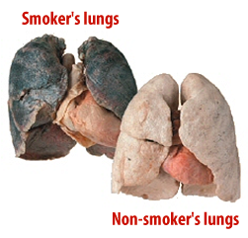
Lung Cancer
Smoking causes lung cancer. Lumps and tumours develop which are cancerous growth that block the air passages and causes suffocation.

Slide 8
Heart diseases
Smoking makes blood clot more easily
Walls of the blood vessels become damages and accumulate fat deposits
The heart has to now pump faster and harder to maintain a normal blood flow
Blood vessels may burst and the person may suffer a stroke
Or if the blood supply is blocked the person may have a heart attack
Smokers are 2 to 3 times more likely to have a heart attack than non-smokers

Slide 9
Bronchitis
Smoking damages the cilia which are tiny hairs that line our air passages that trap dust and germs, so they now enter easily.
This causes the dust to produce a lot of mucus which causes the person to cough continuously known as the smoker’s cough
The air passages become inflamed and the person may suffer from bronchitis
Bronchitis causes the person to not walk properly or even sleep properly.

Slide 10
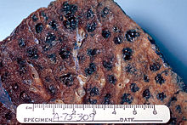
Emphysema
Smoking damages the air sacks in the lungs
More air now has to be moved in and out of the lungs as the gas exchange surfaces are damaged
The damaged lungs and the increased rate of breathing makes breathing very painful
Emphysema prevents people from being active, some persons need a constant supply of oxygen even when sitting

Slide 11
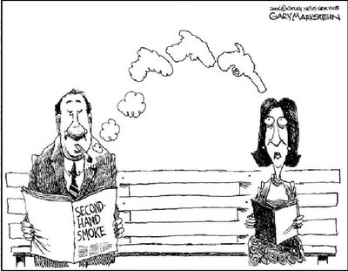
Passive smokers
Passive smokers are persons who do not smoke but who breathe in tobacco smoke from smokers . This smoke is also called second hand smoke
Passive smokers suffer from sore eyes, smoker’s cough, headaches and lung cancer.

Slide 12
ISSUE: WHAT CAN BE DONE TO DISCOURAGE SMOKING?
BOARD OF DIRECTORS MEETING

Slide 13
To discourage smoking:
The public can be educated of the harmful effects of smoking and the advantages of not smoking
Smoking in public places and enclosed places (elevators/air conditioned rooms) can be prohibited \
Warnings can be printed on cigarette packs
Restrict or ban the sale of cigarettes to persons under 18

