Slide 1
The Solar System
Introduction & Components

Slide 2
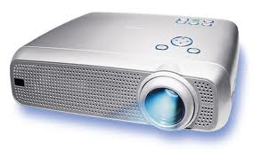
Activity
Look at the projector, is it giving off its own light?
Look at the white board is it giving off its own light?
How is it that the white board seems as if it is producing its own light?

Slide 3
What do you observe when you look at the sky at night?

Slide 4
What do you think?
Do you think the moon produces its own light?
Do you think the stars produce their own light?

Slide 5
Luminous & Non- Luminous
An object which produces its own light is called luminous
An object which reflects the light given off from other objects is called non – luminous

Slide 6
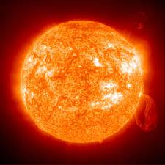
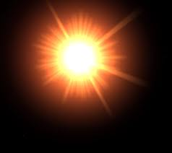
What is a star?
A star is made up of a huge mass of very hot gases.
It gives out a lot of heat and light energy.
The Sun is a star, and is one of the billions of stars in the universe
The universe is made up of all the matter and energy on Earth and in outer space.

Slide 7
Stars
If we look at the sky at night we will see stars
Some of these stars form certain shapes or designs and each of these groups are called a constellation
There are 88 constellations and they are named after mythological characters (e.g Orion – the hunter from Greek mythology), objects (e.g Libra the scale), and animals (e.g. Leo the lion)

Slide 8
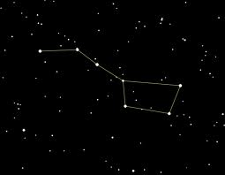
Constellations
Big Dipper
Orion

Slide 9
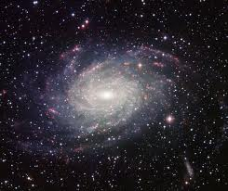
Galaxies
Stars congregate in groups called galaxies
The Sun for example, belongs to a galaxy called The Milky Way
Scientists think that the intergalactic space (space between galaxies) is filled with dark matter which does not give off light.

Slide 10
Hot & Cold Andromeda Galaxy

Slide 11
Whirlpool Galaxy

Slide 12
Where are we?
In San Fernando
In Trinidad
In the Southern Hemisphere
On the Planet Earth
In a galaxy – our galaxy is the Milky Way
Part of the Universe

Slide 13
What does our solar system consist of?

Slide 14
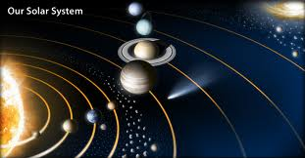
The Solar System
The solar system consists of the Sun together with the eight planets and all other celestial bodies (asteroids, comets) that orbit the sun

Slide 15
Components of the Solar System
Sun (Stars)
Planets
Asteroids
Meteoroids
Meteorites
Meteors
Comets

Slide 16
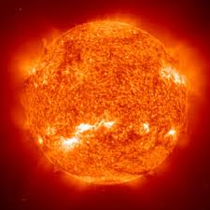
The Sun
The sun is a medium – sized star in the Milky Way
All planets revolve around it

Slide 17
Planets
Planets are non – luminous objects, revolving around a star in space
There are 8 planets and a dwarf planet in our solar system
The inner planets (Mercury, Venus, Earth and Mars) are separated from the outer planets (Jupiter, Saturn, Uranus and Neptune by an asteroid belt
The inner planets are made up of rocks and are known as terrestrial planets
The outer planets are larger than the inner planets and are comprised of gases – they are known as the gas giants
Pluto is a dwarf planet

Slide 18
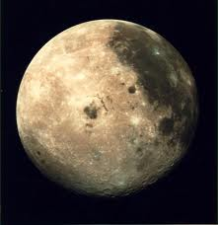
Moons
All of the planets except Mercury and Venus in the solar system have moons which revolve around them .
The moon is non – luminous, it does not produce its own light, it reflects the light of the sun

Slide 19
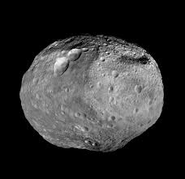
Asteroids
Asteroids are huge rocks revolving around the a star
They range in diameters from a few to several hundred kilometers
Asteroids like planets and moons do not emit light, therefore they are non-luminous.
There is an asteroid belt of rocks between the planets Mars and Jupiter
Planetoids are very huge asteroids with diameters of several hundred kilometers, they are almost planet like.

Slide 20
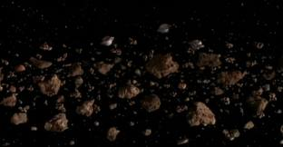
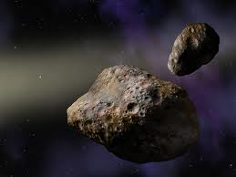
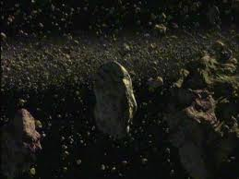
Asteroids

Slide 21
Asteroid Lutetia

Slide 22
Meteoroids
Are Small fragments of rock moving around in space
Sometimes meteoroids and asteroids crash into the surfaces of the planets or their moons and form craters
A meteorite is the remains of a meteoroid which have reached the surface of a planet or moon
Scientists believe that a meteorite impact caused the destruction of the dinosaurs.
A huge crater has been found of the coast of Yucatan Peninsula

Slide 23
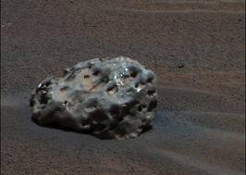
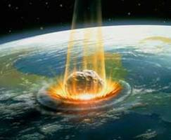
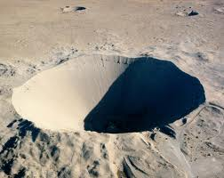
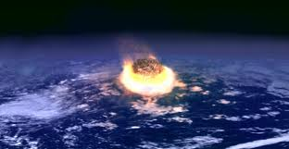
Meteoroid
Meteorite
Dinosaur Meteorite
Crater

Slide 24
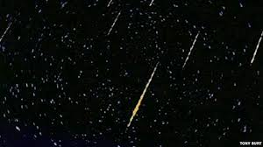
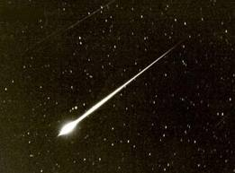
Meteors
Parts of meteoroids burn when they enter the atmosphere of a planet, due to the friction between the gases in the atmosphere and the meteoroids giving off streaks of light
They are called shooting stars, however they are not actually stars

Slide 25
Comets
Comets are giant, dirty snowballs which move around in elliptical orbits around the Sun
As a comet travels towards the Sun some of its ice gets vaporized by the heat form the Sun
A long “tail” is formed behind it
The tail get shorter as it travels away from the Sun
Comets are non-luminous, we can see them because they reflect light from the sun

Slide 26
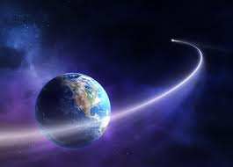
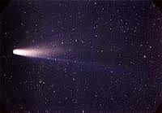
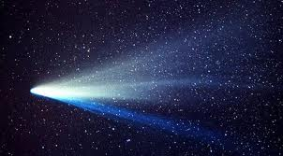
Comets

Slide 28
Activity
From what we have learnt so far, draw a table in your notebooks and divide the constituents of the solar system into luminous and non luminous objects:
Luminous | Non-luminous

